Slide 1


URBAN agendas: an ESSENTIAL TOOL FOR sustainable development
Slussen, Stockholm, Sweden © All Creative Comments
Shipra Narang Suri, PhD
Coordinator,
Urban Planning and Design Branch
United Nations
Human Settlements Programme

Slide 2




urbanization globally
Growing Urban Population Ratio
30%
50%
54%
66%
1930
2008
2014
2050

Slide 3
Urbanization globally
Urban population distribution by region in 2018 and 2030
Notes:
In Northern America, more than half of the population resided in cities with 500,000 inhabitants or more in 2018 and one in five people lived in a city of 5 million inhabitants or more.
LAC is the region with the largest proportion of the total population concentrated in megacities in 2018. 14.2 per cent resided in the six cities with 10 million inhabitants or more.
Between 2018 and 2030, the number of cities with 500,000 inhabitants or more is expected to grow by 57 per cent in Africa and by 23 per cent in Asia.

Slide 4
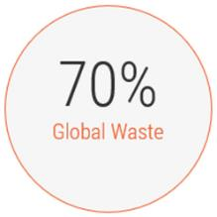
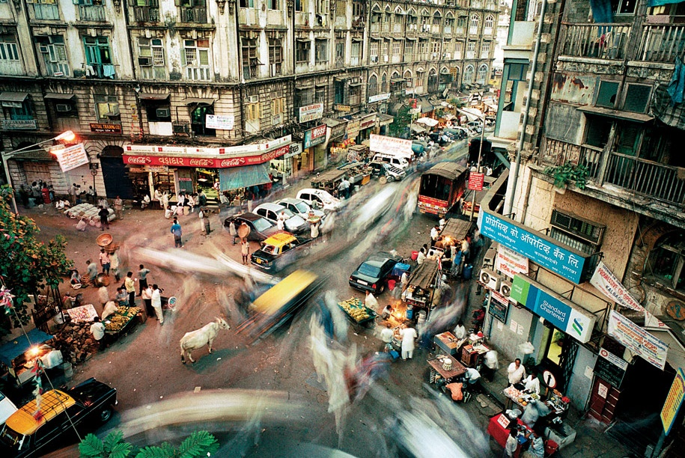

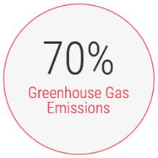
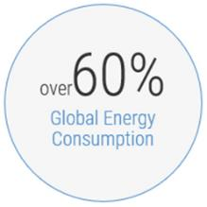
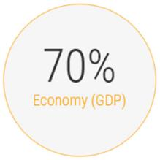
Global trends
Cities today occupy approximately only 2% of the total land
Intermediate cities are experiencing the fastest population growth
Between 2018 and 2030, the number of cities with 500,000 inhabitants or more is expected to grow by 57 per cent in Africa and by 23 per cent in Asia.
Well-planned and designed cities can generate higher levels of societal wellbeing, accelerate global economic growth, and foster sustainable development

Slide 5
Urbanization challenges
Challenges facing Contemporary Cities
Inequality
Environmental Threats
Resources
Technology
Governance

Slide 6
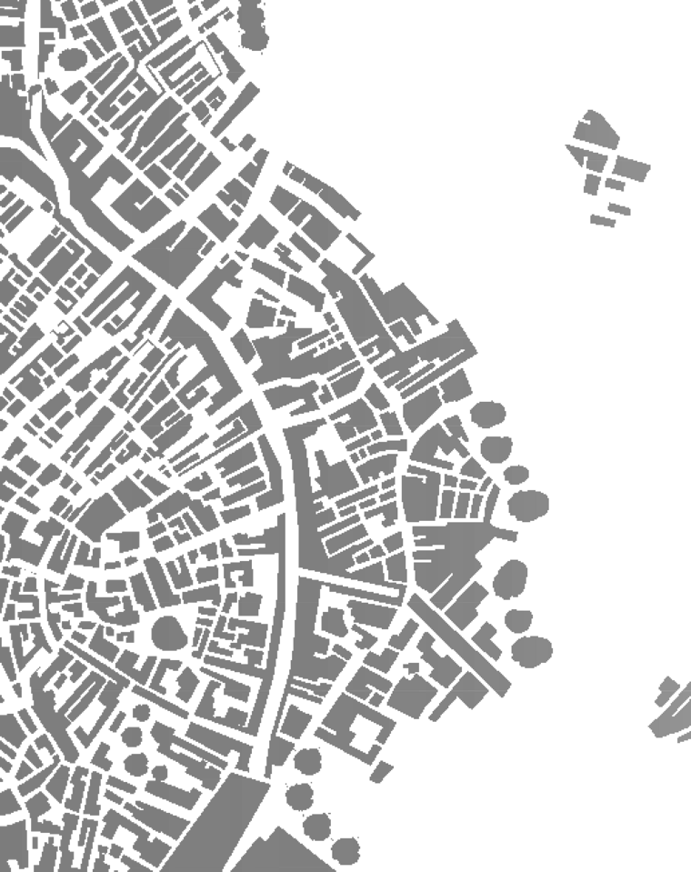
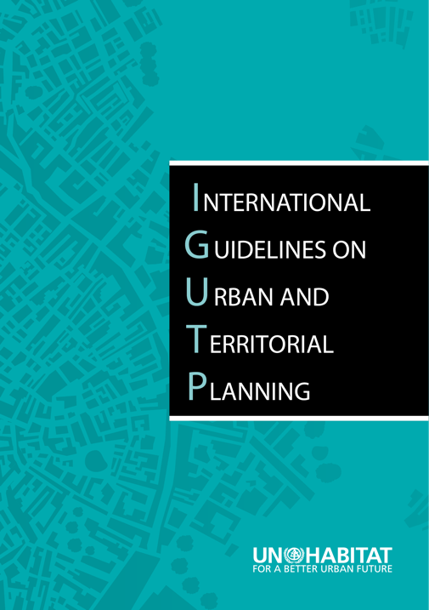
IG-UTP: GLOBAL CONSENSUS ON IMPORTANCE OF planning
Urban and Territorial Planning
Approved in 2015, Resolution 25/6 of the UN-Habitat Governing Council.
A
multi-level
multi-stakeholder
multi-sector
approach to urban and territorial planning.
12
principles
114
action-oriented recommendations
5
levels
4
stakeholder groups
Notes:
The Guidelines are a global reference framework for planning to achieve compact, socially inclusive, institutionally integrated, better connected and more resilient human settlements
A multi-level, multi-sector, and multi-stakeholder approach to spatial planning
Revival of confidence in the essential role of urban planning and design in shaping sustainable development

Slide 7
IG-UTP: Planning AT DIFFERENT LEVELS
Supranational and Transboundary Level:
Multinational regional strategies; Cross border regions; Management of shared resources
National Level:
National plans on planned economic poles infrastructure support
City - Region and Metropolitan Level:
Sub-national regional plans to foster economic development,
Addressing social spatial disparities.
City Municipal Level:
  City development strategies to prioritize investments; land use plans; Urban extension and infill plans
Neighbourhood level:
Streets and public space plans to improve urban quality

Slide 8
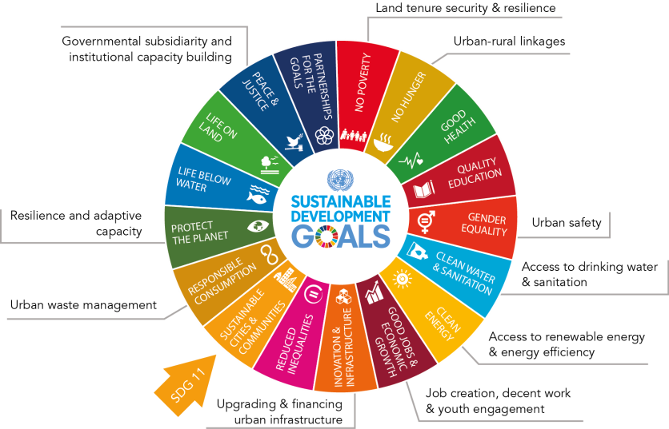
THE SDGs and their urban dimensions
Source: UN-Habitat, 2017, A National Urban Policy for Liberia: Discussion Paper

Slide 9
SDG 11: 10 TARGETS: 15 indicators
Housing and slums
Suitable transport
Participatory planning
Cultural heritage
Disaster and risk reduction
Air quality and waste management
Public spaces
Rural-urban and regional planning
Mitigation of climate change and resilience
LDCs support - Buildings

Slide 10
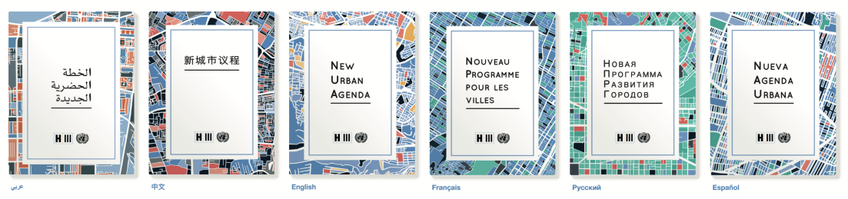
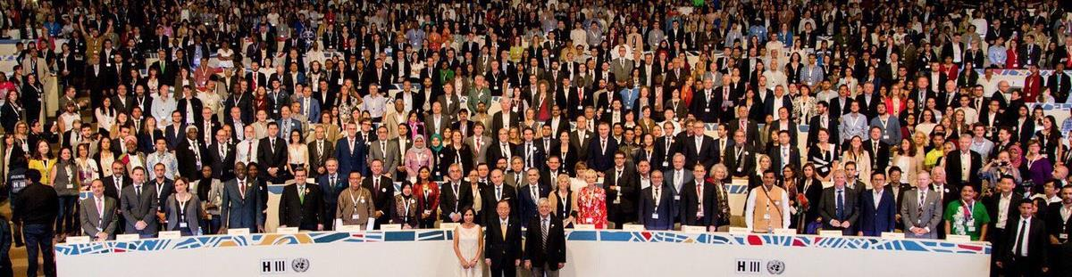
THE NEW URBAN AGENDA: moving from goals to implementation
Habitat III, the United Nations Conference on Housing and Sustainable Urban Development, Quito, Ecuador, October 2016
Notes:
HIGHLIGHT
A shared vision
Three Transformative Commitments
Sustainable Urban Development for Social Inclusion and Ending Poverty
Sustainable and inclusive urban prosperity and opportunities for all
Environmentally resilient and sustainable urban development
Three elements of effective implementation
Building the urban governance structure
Planning and managing urban spatial development
Means of implementation
Follow up and Review
An urbanization action blueprint for UN-Habitat and partners in support of the 2030 Agenda on Sustainable Development; especially SDG 11 - making cities inclusive, safe, resilient and sustainable……..
Guiding Urbanization for the Next 20 Years; Recognizes and integrates IGUTP
UN –Habitat Steers Implementation of NUA through Normative & Operational activities

Slide 11
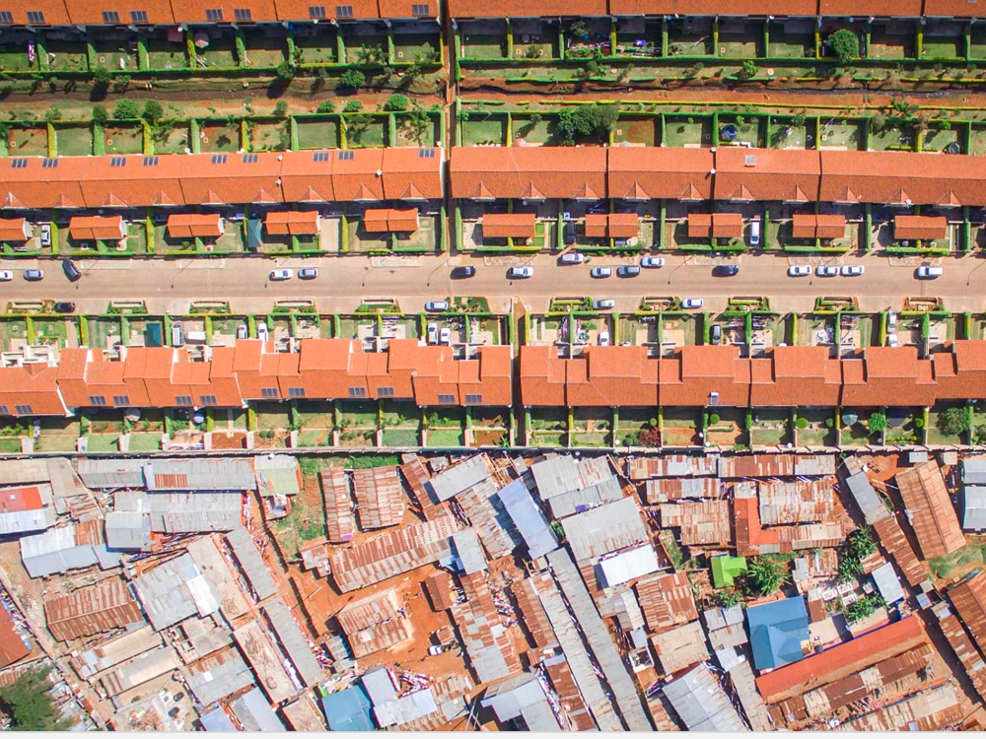
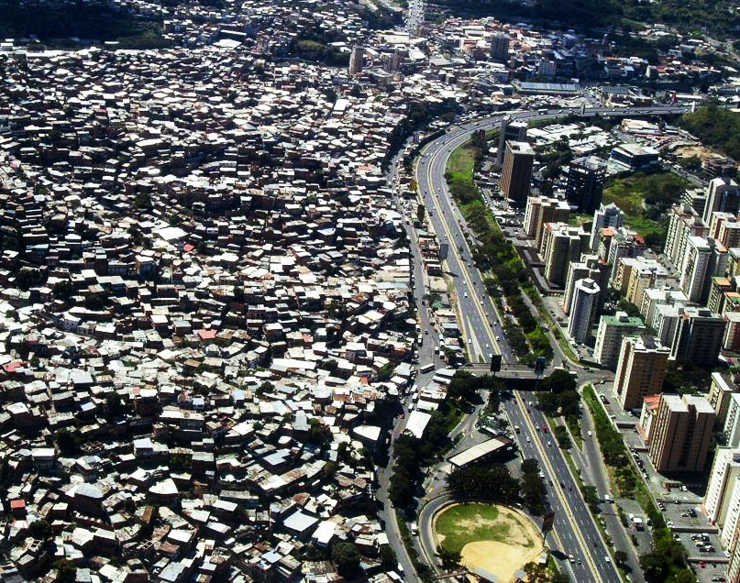
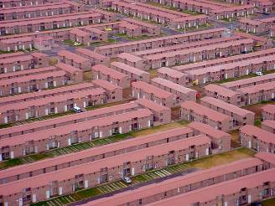
Opportunities and challenges of the global agendas
Mainstreaming of sustainable urbanisation
Beyond the hardware – inclusion, resilience, culture and heritage, governance, financing
Resurgence of Urban policies, planning and design
Capacities
Resources
Data
Knowledge
Notes:
UPD is a central element of many of these global agendas – NUA for examples is peppered with references to UPD, and SDG indicators also make very references to planning – but it presents both an opportunity and a challenge…. Opportunity – I know I’m preaching to the choir here when I say I said planning can help build inclusion, foster engagement, bring coherence, ensure impact at scale, etc…. But challenge…. [next slide]

Slide 12

NATIONAL URBAN POLICies
National and Sub National Frameworks to Safeguard Sustainable Urbanization
National and Sub-national
A coherent set of decisions for the long term
A deliberate government-led process
About coordinating and rallying various actors for a common vision and goal
Aims to promote more transformative, productive, inclusive and resilient urban development
Process and Products for better urbanization Outcomes.
Environmental
National
Regional
Local
NUP
NUP
Social
Economic
Rural
Peri-urban
Urban
NUP

Slide 13
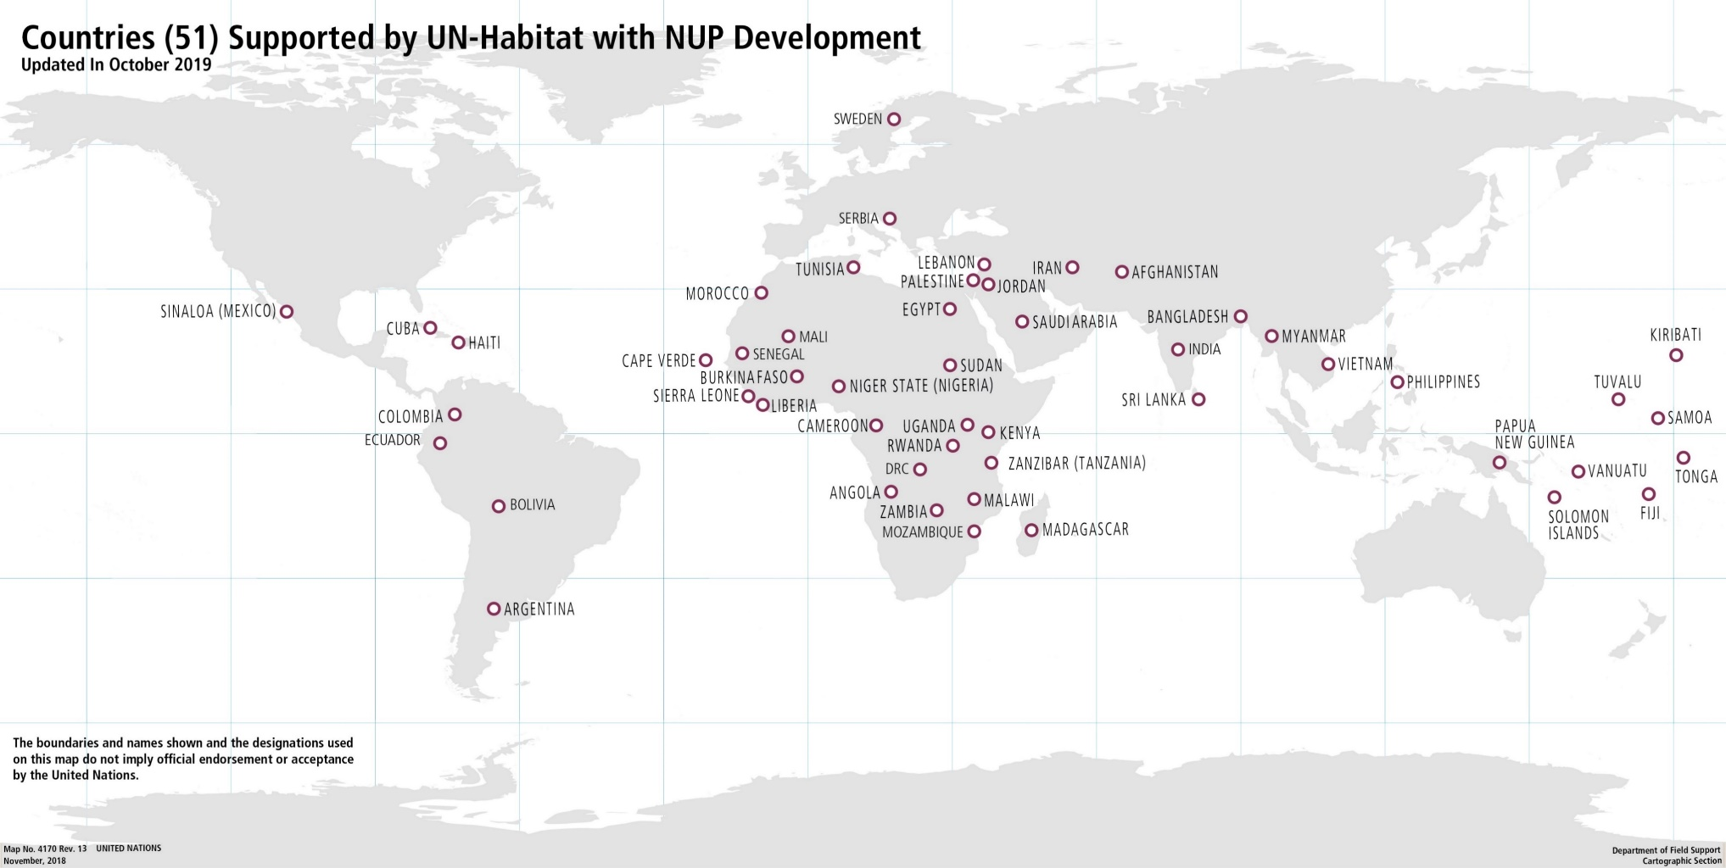
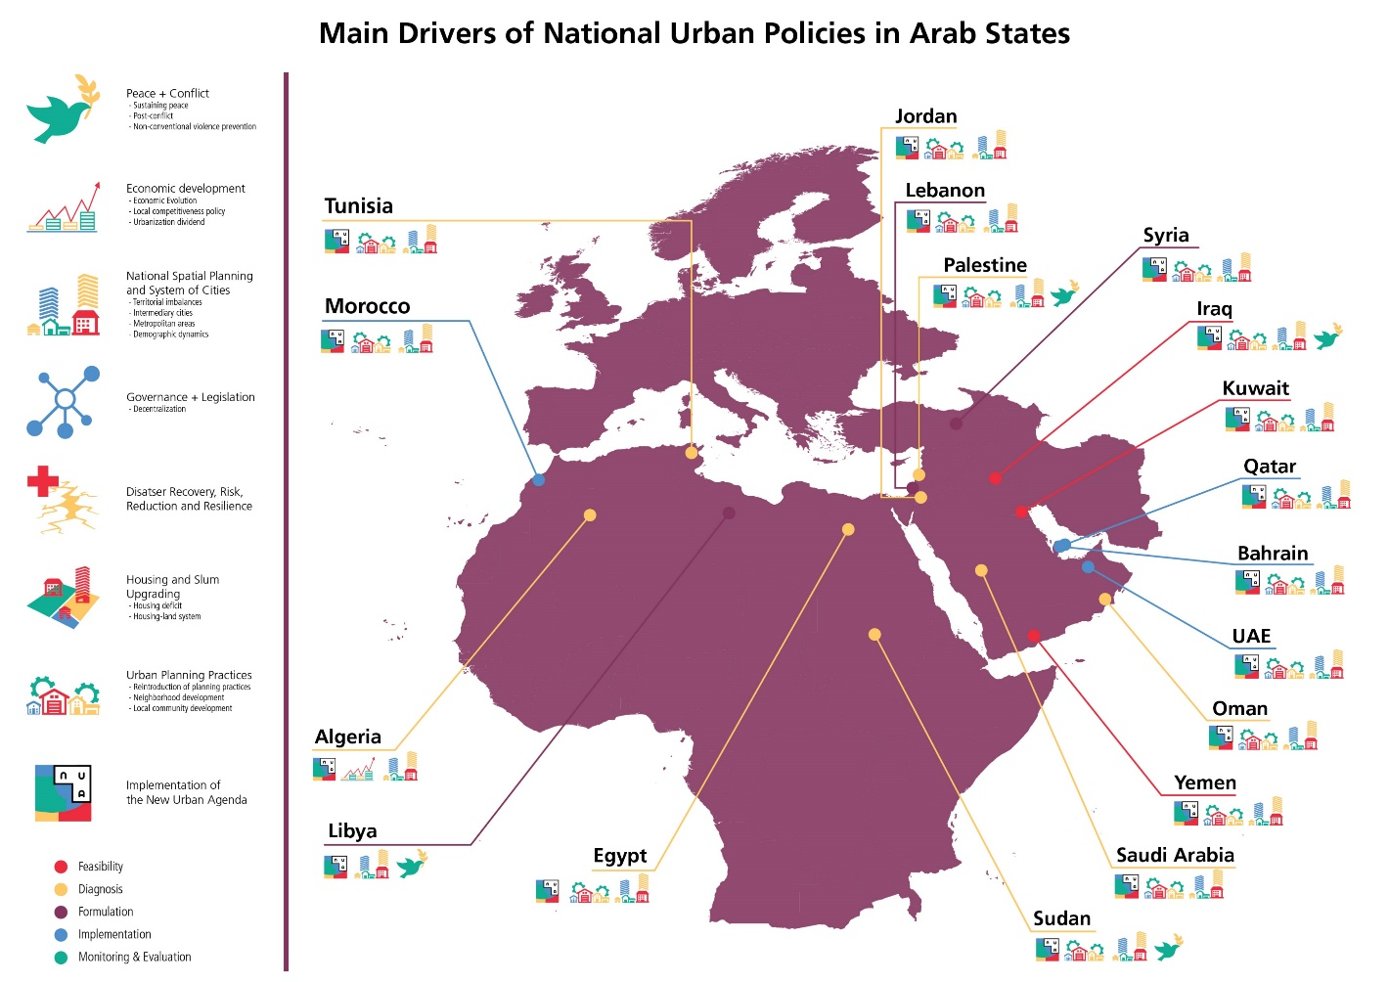
NATIONAL URBAN POLICIES
1 Global Programme: 3 Regional Programmes: 51 National Urban PolicIES: 3 Sub-national urban policy processes
Notes:
At the global level, a partnership of ten leading organisations led to the development of a Policy Paper on National Urban Policies for Habitat 3, and formed an important input to the New Urban Agenda. Building on this, and to respond to the growing demand as well as and enhance cross-learning through partnerships, the global National Urban Policy Programme was set up as a joint initiative and partnership of UN-Habitat, OECD and Cities Alliance. Through this partnership, a Global report on NUP has been produced and three International Conferences on NUP (2015, 2017 and 2019) organized. Another important indicator of success is the recognition of the NUP as one of the SDGs indicators for Target 11a, reported annually since 2017, drawing from the NUP database developed by UN-Habitat.
Three regional programmes on NUP focusing on specific regional priorities (climate change in Asia and the Pacific, urban-rural linkages in Africa, and economic development in Arab region), have also been developed.
At national level, 50 countries are now being supported by UN-Habitat, up from 4 at the beginning of 2014. Of these, at least 15 have directly provided funding to UN-Habitat to assist them developing their NUPs while other funding has been secured through the United Nations Development Account and development partners (e.g. Korea, Sweden, Spain), who received requests from countries and channeled them to UN-Habitat.
A total of 10 sub-national governments have also requested and been supported by UN-Habitat to put in place adequate frameworks to guide their urbanization (e.g. in Mali, Palestine, Bolivia, Guinea, Papua New Guinea, Tuvalu, Kiribati, Samoa, Tonga and Vanuatu).
Countries and sub-national governments supported by UN-Habitat in establishing their NUP frameworks are now identifying the transformative projects aligned with their Urban Policies (e.g. Malawi).

Slide 14



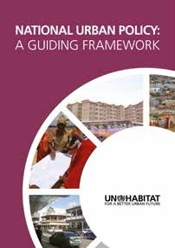


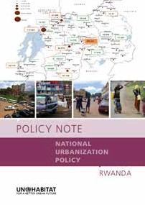
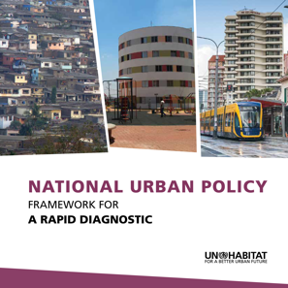
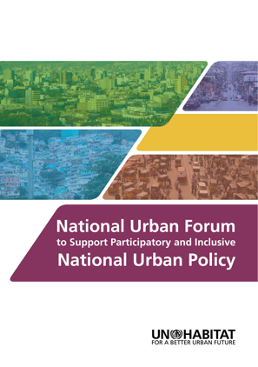
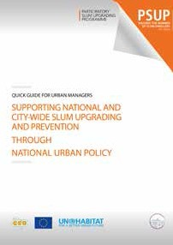
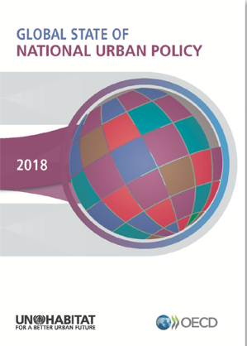
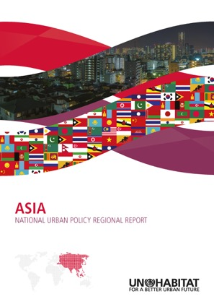
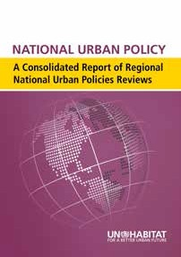
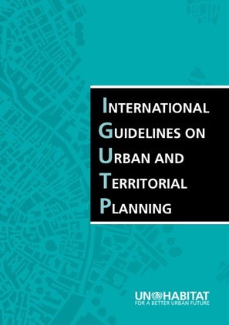
Selected NUP tools
Available in
English
•
French
•
Spanish
•
The Evolution of
National Urban Policies
A Global Overview
Notes:
“Socially Inclusive National Urban Policies Guide” (currently in-process). Expert Group Meeting on Socially Inclusive NUP has progressed hand-in-hand with influencing the Bolivian National Urban Policy Process towards an inclusive process, with the engagement of grass-roots organizations and civil society.
Addressing climate change in National Urban Policy has led to the development of “A Policy guide for Low-Carbon and Climate-Resilient Urban development”, which has also been implemented in some countries e.g. Zanzibar. Zanzibar NUP stakeholders have been provided with guidance for addressing climate change challenges thought their National Urban Policy, for long term solutions.

Slide 15
National urban policies: recent developments
Endorsement of new SDG indicator 11.a, which strengthens and demonstrates the significant role NUPs play in urban development.
“Number of countries that have national urban policies or regional development plans that: (a) respond to population dynamics, (b) ensure balanced territorial development, (c) increase local fiscal space”.
Expected to be fully adopted and endorsed at the 51st Session of the UN Statistical Commission in New York in March 2020.
Adoption of the UN-Habitat Strategic Plan 2020-2023 with four domains of change:
  Reduced spatial inequality and poverty in communities across urban-rural continuum,
  Enhanced shared prosperity for cities and regions,
  Strengthened climate action and improved urban environment, and
  Effective urban crisis prevention and response
Recognises urban policy, governance and legislation as fundamental drivers of change.
Underscores the role of NUP to bring together disjointed energies and the potential of urban centres within national systems of cities.
Notes:
UPD is a central element of many of these global agendas – NUA for examples is peppered with references to UPD, and SDG indicators also make very references to planning – but it presents both an opportunity and a challenge…. Opportunity – I know I’m preaching to the choir here when I say I said planning can help build inclusion, foster engagement, bring coherence, ensure impact at scale, etc…. But challenge…. [next slide]

Slide 16

www.unhabitat.org

